Slide 1
Lesson 3
BUIDLING MOBILE APPS WITH REACT NATIVE

Slide 2
Lesson 4
PART 1

Slide 3

What is REACT NATIVE?
React Native is an open source framework for building native Android and iOS applications using React and the app platform’s native capabilities.
With React Native, you use JavaScript to access your platform’s APIs such as Camera and push notifications.
We shall also use React Components to define the appearance and behavior of your UI

Slide 4

What is REACT
React, sometimes referred to as a frontend JavaScript framework, is a JavaScript library created by Facebook and used for building UI components.

Slide 5
REACT-DOM vs REACT-NATIVE
REACT uses REACT-DOM, while REACT NATIVE uses REACT-NATIVE libraries
React DOM uses HTML, CSS, and JavaScript for layout and styling of Web Apps.
React Native, on the other hand, uses native UI components and APIs to create cross-platform Mobile applications.

Slide 6
Why REACT-NATIVE?
IOS apps require swift or objective-C
Android apps require java or kotlin
Global distribution of users is approx.:31% on IOS and 68% on Android
Need to develop two separate Apps using different technologies
With REACT-NATIVE, you can create one App that seamlessly works on both platforms

Slide 7
PRE-REQUISITES
JavaScript:(https://www.w3schools.com/js/default.asp)
REACT fundamentals(https://www.w3schools.com/REACT/DEFAULT.ASP)

Slide 8


WHAT IS EXPO?
Expo is a set of tools and services built around React Native apps with consolidated logic for both iOS and Android..
The alternative tool is the React Native CLI which is the traditional approach for building React Native apps.

Slide 9
ADVANTAGES of Expo vs REACT-NATIVE CLI
Access to Pre-built Libraries: provides a wide range of pre-built libraries and APIs.
Simplified Build Process: handles the build process for you, abstracting away the need to configure build tools and deal with native code compilation.
Native Physical Device: you can have the Expo Go app installed in your mobile and connect over the same network and get your app tested on any physical device [both Android and iOS].
No need for a mac to build an iOS App. Code can be built and deployed to the cloud. From there you can directly deploy it to the store.
Disadvantage:
Limited Native Modules: Expo restricts access to certain native modules, which means you may encounter limitations when trying to integrate certain third-party libraries or accessing low-level device features.

Slide 10
PART TWO
PROJECT STRUCTURE

Slide 11
INTRODUCTION
When you create a new Expo project, a few files and folders are provided by default.
Lets list out the essential files and folders that are necessary for you to understand when developing your app.

Slide 12
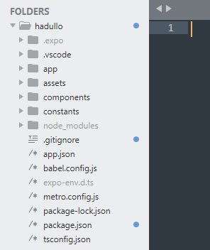
React native App in Sublime Text Editor

Slide 13
App.js
The App.js file is the default screen of your project.
It is the root file that you'll load after running the development server with npx expo start.
You can edit this file to see the project update instantly.
Generally, this file will contain root-level React Contexts and navigation.

Slide 14
app.json
The app.json file contains configuration options for the project.
These options change the behavior of your project while developing, in addition to while building, submitting, and updating our app.

Slide 15
Assets folder
The assets folder contains adaptive-icon.png used for Android and an icon.png used for iOS as an app icon.
It also contains splash.png which is an image for the project's splash screen and a favicon.png if the app runs in a browser.
The assets directory is not special-cased, and our project can have images and other assets placed anywhere in our project structure.

Slide 16
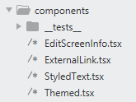
Components folder
The components directory is where you should put all your reusable components.
Each component should have its own directory with the following files (it is similar to the screen folder structure)

Slide 17
Other standard files
The standard files listed below are part of every project created with Expo CLI.
You can edit them to customize your project.

Slide 18
.gitignore
A .gitignore allows you to list files and folders that you don't want to be tracked by Git.
You can modify the files to list other files and folders in your project.
Generally, the default list is sufficient for most projects.

Slide 19
babel.config.js
Applies the babel-preset-expo preset that extends the default React Native preset and adds support for decorators, tree-shaking web packages, and loading font icons with optional native dependencies if they're installed.
You can also modify this file to add additional Babel plugins or presets.

Slide 20
package.json
The package.json file contains the project's dependencies, scripts and metadata.
Anytime a new dependency is added to your project, it will be added to this file.
You can also modify the scripts to add or remove them.
Four default scripts are provided to trigger the development server of your project such as expo start, expo start --android, expo start --ios, and expo start --web.

Slide 21
Devices For Running Expo App(Mobile App)
IOS Device
Android Device(using expo)
IOS simulator
Android Emulator

Slide 22
END OF PART TWO
THANK YOU

Slide 23
PART 3
SETTING UP THE DEVELOPMENT ENVIRONMENT

Slide 24
SETTING UP THE DEVELOPMENT ENVIRONMENT
Install Node.js on your computer
Install Vs Code
Install Expo Go on your smartphone from Google Play store
Create your project Folder called React-Native on your Desktop
Open the folder in VsCode
Install REACT NATIVE using Expo as follows

Slide 25
Installing Steps: React Native
Run the following command to create a new React Native project called “bmcsApp":
npx create-expo-app BMCSapp1 or npx create-expo-app@latest BMCSapp1Cd to: mscApp1
Run:npx expo start to generate the QR code
Ensure both your computer and phone device are connected to same network
Open the Expo Go app and use to scan the QR code
The Expo mscApp installed in computer now runs in your device
Incase it takes very long to run or there are errors, do the following

Slide 26
Incase of errors, set default `CONNECTION` to `tunnel` as shown
Change the "start" script in package.json to "expo start --tunnel".
"scripts": {
"start": "expo start --tunnel",
"android": "expo start --android",
"ios": "expo start --ios",
"web": "expo start --web",
"eject": "expo eject"
},
Then, you need to run the command directly:
npx expo start --tunnel

Slide 27
Connection Gives error on 1st attempt but connects on 2^{nd Attempt}
Starting Metro Bundler
CommandError: ngrok tunnel took too long to connect.
PS C:\Users\HP\Desktop\MSCIT-MOBILE\RN2\hadullo> npx expo start --tunnel
Starting project at C:\Users\HP\Desktop\MSCIT-MOBILE\RN2\hadullo
Starting Metro Bundler
Tunnel connected.

Slide 28
END OF PART 3
THANK YOU

Slide 29
PART 4
DEVELOPMENT WITH REACT NATIVE COMPONENTS

Slide 30
INTRODUCTION
Components are independent and reusable bits of code.
They serve the same purpose as JavaScript functions, but work in isolation and return HTML.
Two types, Class components and Function components,
REACT is used to create web user interface via HTML tags such as div, span and paragraph

Slide 31
CLASS COMPONENT
A class component must include the extends React.Component statement.
This statement creates an inheritance to React.Component, and gives your component access to React.Component's functions.
The component also requires a render() method, this method returns HTML.
Create a Class component called Car
class Car extends React.Component {
render() {
return <h2>Hi, I am a Car!</h2>;
}
}

Slide 32
FUNCTION COMPONENT
Here is the same example as above, but created using a Function component instead.
A Function component also returns HTML, and behaves much the same way as a Class component, but Function components can be written using much less code.
Create a Function component called Car
function Car() {
return <h2>Hi, I am a Car!</h2>;
}

Slide 33
REACT NATIVE COMPONENTS
React uses the virtual DOM (Document Object Model) to render code in a web browser.
React Native uses native APIs to render UIs on mobile devices.
In Android development, you write views in Kotlin or Java;
in iOS development, you use Swift or Objective-C.

Slide 34
REACT NATIVE COMPONENTS(cont.)
With React Native, you can invoke these views with JavaScript using React components.
At runtime, React Native creates the corresponding Android and iOS views for those components.

Slide 35
REACT NATIVE COMPONENTS(cont.)
Because React Native components are backed by the same views as Android and iOS, React Native apps look, feel, and perform like any other apps.
We call these platform-backed components Native Components.

Slide 36
THE CORE COMPONENTS
REACT NATIVE UI COMPONENT | ANDROID VIEW | IOS VIEW | WEB ANALOG | DESCRIPTION
<View> | <ViewGroup> | <UIView> | A non-scrolling <div> | A container that supports layout with flexbox, style, some touch handling, and accessibility controls
<Text> | <TextView> | <UITextView> | <p> | Displays, styles, and nests strings of text and even handles touch events
<Image> | <ImageView> | <UIImageView> | <img> | Displays different types of images
<ScrollView> | <ScrollView> | <UIScrollView> | <div> | A generic scrolling container that can contain multiple components and views
<TextInput> | <EditText> | <UITextField> | <input type="text"> | Allows the user to enter text

Slide 37
VIEWS
View in Android is like Div in Web
In Android and iOS development, a view is the basic building block of UI:
a small rectangular element on the screen which can be used to display text, images, or respond to user input.
Even the smallest visual elements of an app, like a line of text or a button, are kinds of views.
Some kinds of views can contain other views. It’s views all the way down!

Slide 38
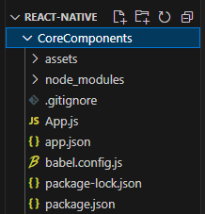
Creating a Blank Project
npx create-expo-app@latest CoreComponents --template blank@sdk-49

Slide 39
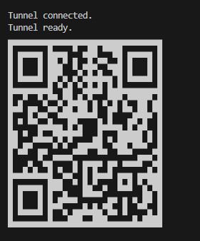
Starting the Project
npx npm start

Slide 40
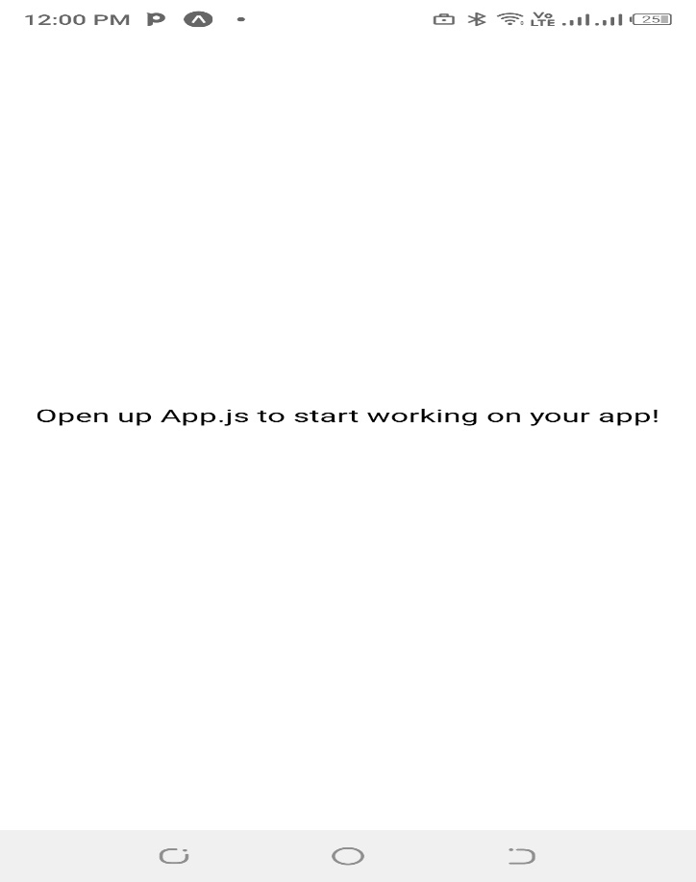
Mobile Screen on Expo

Slide 41
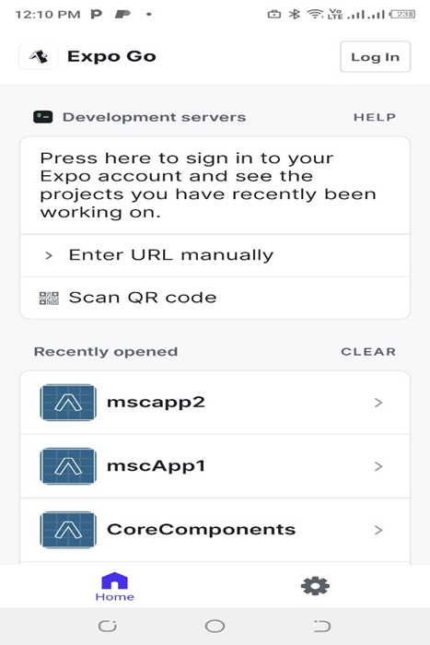
Mobile Screen on Expo(cont.)

Slide 42
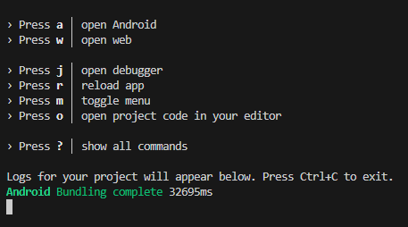
Viewing Options
Click w to open on web view

Slide 43
After Pressing w for web view
It looks like you're trying to use web support but don't have the required dependencies installed.
Please install react-native-web@~0.19.6, react-dom@18.2.0, @expo/webpack-config@^19.0.0 by running:
npx expo install react-native-web@~0.19.6 react-dom@18.2.0 @expo/webpack-config@^19.0.0

Slide 44
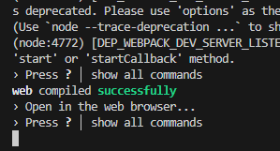
Installing web pack

Slide 45
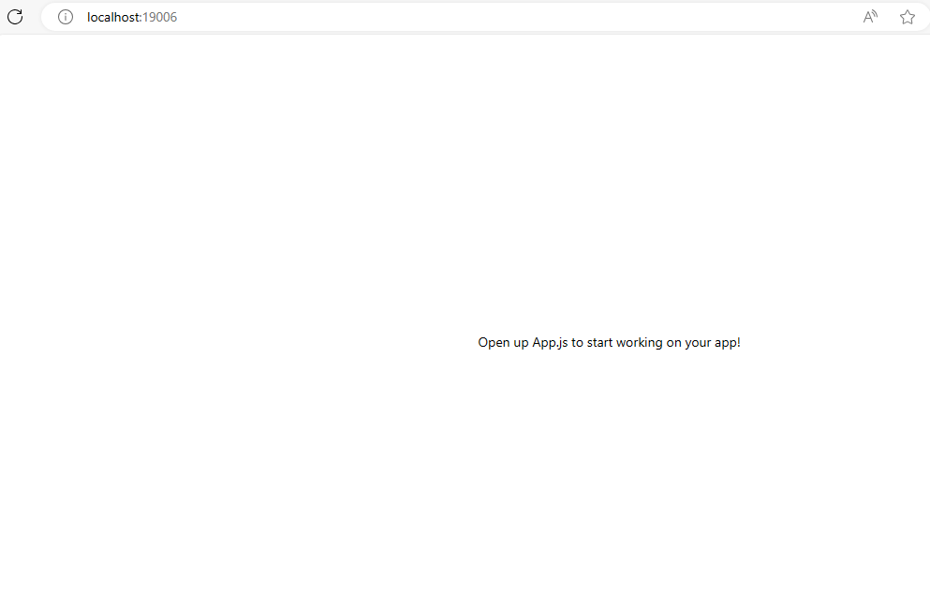
App showing in Web Browser

Slide 46
VIEWS AND VIEW NESTING
Delete everting in app.js and Create this Code in app.js
import {View } from 'react-native'
export default function App(){
return (
<View style = {{ flex:1, backgroundColor:"red" }}>
<View style = {{width:200, height:200, backgroundColor:"blue" }}>
</View>
<View style = {{width:200, height:200, backgroundColor:"green" }}>
</View>
</View>
);
}

Slide 47
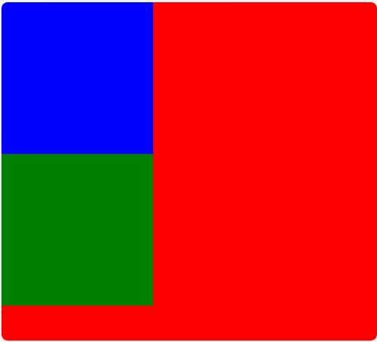
VIEWS AND VIEW NESTING(cont.)
Output on web Pack

Slide 48
TEXT
A React component for displaying text.
Text supports nesting, styling, and touch handling.
Depending on the target platform, React-Native will translate this component to either a UI TextView(iOS), a TextView(android) or a ‘p’ (web)

Slide 49
CREATING TEXT
Import a Text View and Wrap Text in Text Component
import {View, Text } from 'react-native'
export default function App(){
return (
<View style = {{ flex:1, backgroundColor:"red" }}>
<Text>HellO MSC IT TUM</Text>
</View>
);
}

Slide 50
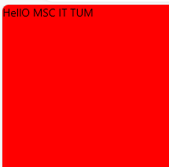
TEXT OUTPUT ON WEB
Text positioning not proper

Slide 51
TEXT PADDING OF 100
Adding a Padding in the View
import {View, Text } from 'react-native'
export default function App(){
return (
<View style = {{ flex:1, backgroundColor:"red“, padding:100 }}>
<Text>HellO MSC IT TUM</Text>
</View>
);
}

Slide 52
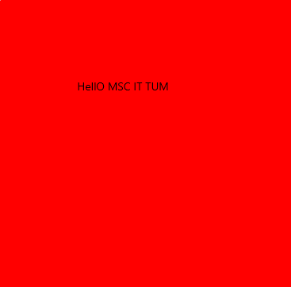
TEXT OUTPUT ON WEB
Text positioning with a padding of 100 improves

Slide 53
TEXT FORMATTING
Adding a Padding in the View
import {View, Text } from 'react-native'
export default function App(){
return (
<View style = {{ flex:1, backgroundColor:"red", padding:100}}>
<Text>
<Text style = {{ fontSize:30, color: 'white' }}>Hello</Text> MSC IT TUM
</Text>
</View>
);
}

Slide 54
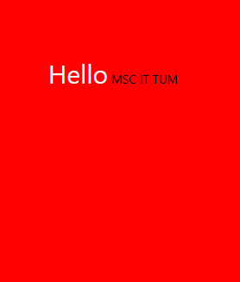
TEXT FORMATTING OUTPUT
Text Formatting

Slide 55
IMAGE
A React component for displaying different types of images, including network images, static resources, temporary local images, and images from local disk, such as the camera roll.
This example shows fetching and displaying an image from local storage as well as one from network and even from data provided in the 'data:' uri scheme.

Slide 56
THE END
Thank you!

